Slide 1
Decision Tree

Slide 2
Decision Tree classfier
Decision tree classifier is mostly used classification algorithm because of its advantages over other classification algorithms.

Slide 3
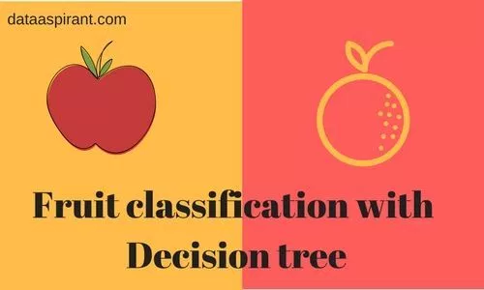

Slide 4
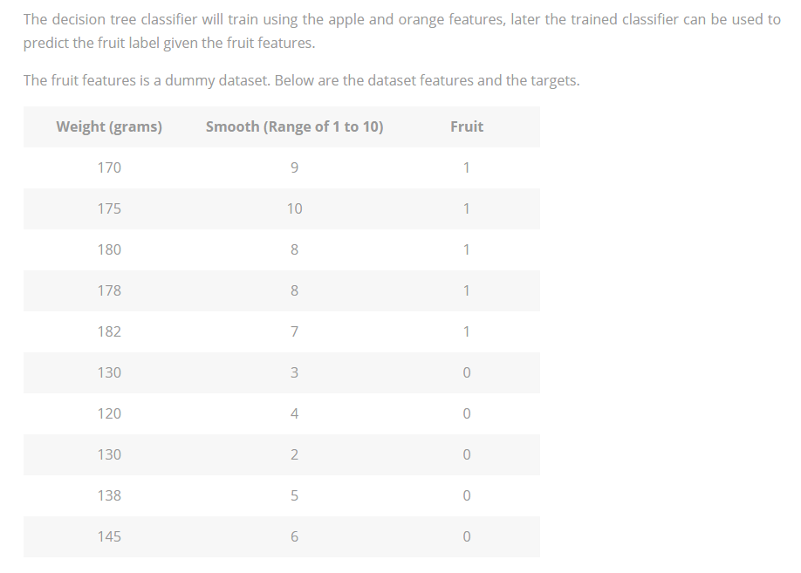

Slide 5
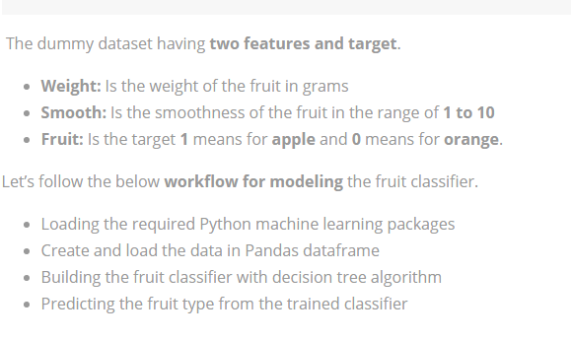

Slide 6
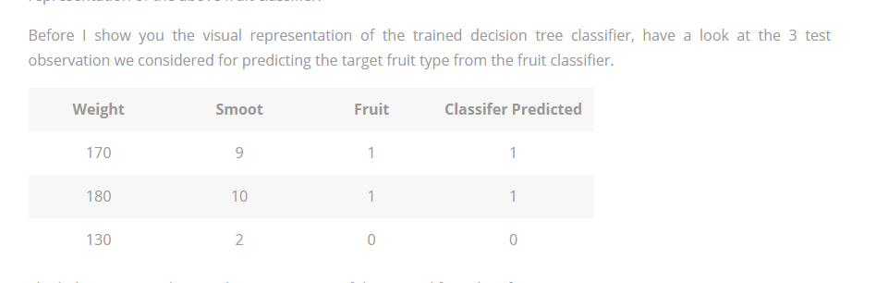

Slide 7
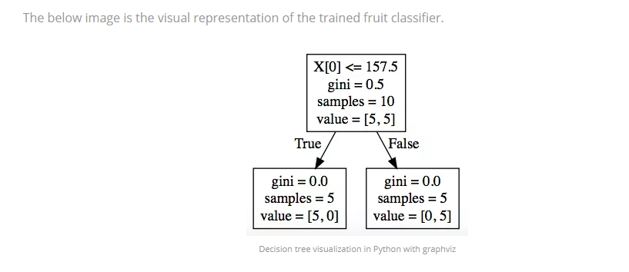

Slide 8
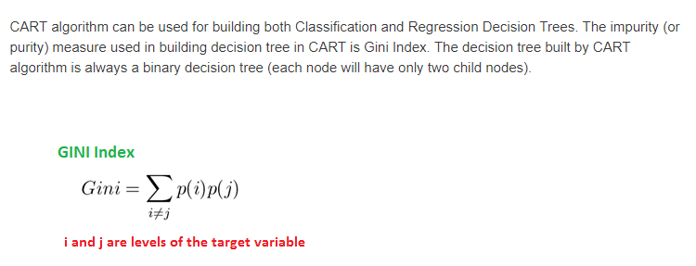
Gini Index
CART (Classification and Regression Tree)

Slide 9
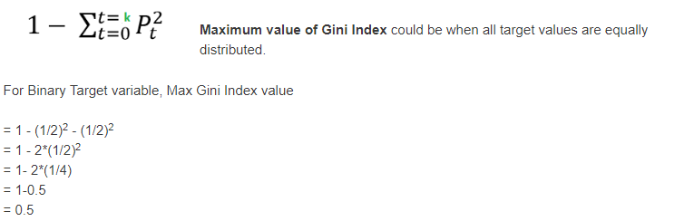
Maximum value of Gini Index could be when all target values are equally distributed.

Slide 10
Similarly for Nominal variable with k level, the maximum value Gini Index is
= 1 - 1/k
Minimum value of Gini Index will be 0 when all observations belong to one label.

